Slide 1
PRELIMINARY CONCEPTS
UNIT-1

Slide 3
Unit-I
Reasons for studying concepts of programming languages
Programming domains
Language evaluation criteria
Influence on language design
Language categories
language design trade-offs
implementation methods
Programming environments
Syntax and Semantics
General problem of describing syntax and Semantics
Formal Methods of Describing syntax BNF, EBNF for common programming Features
Parse tree
Ambiguous Grammars, Attribute Grammars
Denotational Semantics and Axiomatic semantics

Slide 4
Reasons for studying concepts of programming language
These are the some of the reasons/ potential benefits of studying concepts of programming language,
  Increased capacity of express ideas.
  Improved background to choose appropriate language.
  Increased ability to learn new language.
  Better understanding of the significance of implementation.
  Better use of language that are already known.
  Overall advancement of computing.

Slide 5
1,Increased Capacity to Express Ideas:
Weak in language Weak in expressing Ideas.
Without understanding the capabilities of the language/limitations of the language We cannot program perfectly.
So, the study of programming language concepts increase the programmers capacity to express ideas better.
2.Improved Background to choose appropriate language
What happens here is , professional programmers/ company trained developers learns only 1 or 2 languages. In which they are trained for particular project.
Some times, they are unaware of new features of new languages.
Some time, they may choose a language familiar to them even it is poorly suited to project.
All this happen due to lack of proper background of languages. So studying of concepts of Programming Language improves the background to choose appropriate language.

Slide 6
3.Increased ability to learn new language:
We all know for every quarter(1/4) year/ 6 months we are hearing new languages(Android, Python, Ruby, Cloud Computing)
So, to understand and to be with latest domain(technologies) understanding the concepts and implementations will help us to increase our ability to learn new language.
For example: Understanding OOP concepts will help to learn the language which are built on the concept of OOPS(C++, Java, Android, C#,..)
4.Better understanding of the significance of implementation
Understanding the implementations help us to understand why the languages developed.
This knowledge leads us to use the language properly.
Finding and fixing the bugs(errors) will easy.
We can understand and realize efficiency of the language.

Slide 7
5.Better use of the language that are already known:
We known understanding and learning all the feature of language are complex and takes more time.
Employing concepts of Programming language we can easily learn the capability and complex feature.
Better understanding of the language better use of it.
6.Overall advancement of computing:
We all known only few languages very popular(C,C++ ,Java).
ALGOL60 displaced FORTRAN:- Better control statements and other few reasons than after ALGOL was displaced an so on.
Understanding concepts of Programming Language lays foundations for new advancements in computing..

Slide 8
Programming Domains:
Programming domains is nothing but the language in which we develop programs/projects.
We list out different programming domains based on their application area
  Scientific Applications.
  Business Applications.
  Artificial Intelligence.
  System Programming.
  Scripting Languages
a) Scientific Applications:
1.The first digital computers, which appeared in the 1940, were used and in fact invented for scientific applications.
2.Typically, scientific applications have simple data structures but require large numbers of floating computations(Arithmetic operations)
  The first language for scientific applications is FORTRAN(FORMALE TRANSALTION LANGAUGE)..
  Next ALGOL(ALGORTHMIC LANGUAGE) 60 and its descendants are also intended for scientific applications

Slide 9
b) Business Applications:
1.The use of computers for business applications began in the 1950s.
2.Special computers were developed for this purpose, along with special languages.
  The first highly successful language for business was COBOL(COMMON BUSINESS ORIENTED LANGUAGE) in 1960.
  After that several improvements various versions of COBOL are released.
c) Artificial Intelligence:
1.Artificial intelligence (AI) is a broad area of computer applications characterized by the use of symbolic rather than numeric computations.
2.Symbolic computation means that symbols, consisting of names rather than numbers are manipulated.
3. Symbolic computation is more conveniently done with linked list of data rather than array.
The first widely used programming language for AI is LISP(LIST PROCESSING LANGUAGE).
  An alternative approach to some of these applications- logic programming using PROLOG.
  Some how ‘C’- Language is also used in AI programming.

Slide 10
d) System Programming:
The Operating system and all of the programming support tools of a computer system are collectively known as its system software., drives and firmware which controls the systems are known as system software.
In 1960s & 1970s IBM, Digitals & other system manufactures developed a special languages for the system programming.
For IBM mainframe computers, the language was PL/S, a dialect of PL/I; for digital, it was BLISS
  For some OS like UNIX is completely written in ‘C’, which has made it relatively easy to port, or move, to different machines.

Slide 11
e) Scripting Languages:
1.Early scripting languages were used by putting list of commands, called a script in a file to be executed.
2.The first of these languages, named sh (for shell), began as a small collection of Commands that were interpreted as calls to system subprograms that performed utility functions, such as file management and simple file filtering.
3.One of the most powerful and widely known of these is ksh (Bolsky and Korn 1995)
4. awk is another scripting language developed by Al Aho, Kernighan and Peter Wienberger at Bell Laboratories.
5. The Perl language, developed by Larry Wall, was originally a combination of sh and awk .
6.Java Script (Flanagan,1998) is a scripting language developed by Netscape for use in both Web servers and browsers.
7.PHP is a scripting language developed designed by Rasmus Leadorf for use on Web server systems.

Slide 12
f. Special-Purpose Languages:
A host of special-purpose languages have appeared over the
past 40 years.
1.The range from RPG, which is used to produce business
reports.
2. APT is used for instructing programmable machine tools.
3. GPSS is used for system simulation.

Slide 13
Language Evaluation Criteria
Here, We evaluate the features, that mainly focus software development process.
Following table shows language evaluation criteria and characteristics that affect them.
 | CRITERIA
CHARACTERSTIC | READABILITY | WRITABILTY | RELIABILITY
Simplicity | ✓ | ✓ | ✓
Orthogonality | ✓ | ✓ | ✓
Control Structures | ✓ | ✓ | ✓
Data Types & Structures | ✓ | ✓ | ✓
Syntax Design | ✓ | ✓ | ✓
Support for Abstraction |  | ✓ | ✓
Expressivity |  |  | ✓
Type Checking |  |  | ✓
Exception Handling |  |  | ✓
Restricted Aliasing |  |  | ✓

Slide 14
Readability:
One of the most important criteria for judging a PL is the ease with which programs can be read and understand.
  In 1970’s after software life cycle concepts were introduced & coding was given to a smaller role and maintenance was recognized as a major part of the cycle.
  maintenance was determined by readability of the code. So readability become one of the important language evaluation criteria.

Slide 15
1.Simplicity:
Following are the factors that effects simplicity,
i. Large no. of Constructs:-
The language with large no. of constructs(features) are difficult to understand than smaller number.
ii. Feature Multiplicity:-
Having more than one way to solve a problem.
Example:
count=count+1
count+=1
count++
++count
All are having same meaning when used stand alone
expressions

Slide 16
iii. Operator overloading:-
A single operator symbol has more than one meaning
Somehow, operator with more than one meaning effects the readability.
For example to overload + to use it for both integer and floating-point addition.
However, suppose the programmer defined + used between single-dimensioned array operands to mean the sum of all elements of both arrays.
2.Orthogonality
To understand the orthogonality lets consider example:
    Suppose language has four primitive types( Integer, float, doubt & char) and types of vectors(Arrays, Pointer).
    If the two types can be applied on the primitive types we can define a large set of data structures.
    The lack of orthogonality leads exceptions in language rules. For examples if pointers are not allowed to point arrays, many of those possibilities would be eliminated (linked lists, tree, Graphs).

Slide 17
3.Control Statements:
In 1950’s to 1960’s ‘goto’ statement is widely used we all know use of goto statement reduces the program readability. So, in 1970’s structured programming are introduced.
Example:
while(a<=100)
{
printf(”a=%d”,a);
}
loop:
if(a<=100)
printf(“a=%d”,a)
goto loop
else
goto Exit
Exit:
Adequate no. of control statements allows users to write well structured programs which are readable.

Slide 18
4.Data types & Structures:
An adequate no. of data types & structures can increase the readability of program.
Example:
C-language Java
For representing a ‘flag’ flag=true or false
flag=1 or 0 java as a 8 primitive types
Here we represent with in that ‘boolean’ defines
because ‘C’-lacks with true or false
Boolean data types)
Similarly adequate no. of structures can also increase readability.
Example:
To represent employee record, it can be done in 2 ways.
with arrays structure or record
char name[20]; struct employee{
int age; char name[20];
char address[10]; int age;
double salary; char address[100];
double salary;
};
structure employee CSE[100];

Slide 19
5. Syntax Design:
Syntax design plays a key role in language readability.
For suppose, Identifier form:-
Restricting the length of the identifier effects the readability of the language.
  Example:
  Max length allowed in FORTRAN is ‘6’, we need to cut shot the names, indeed which decreases the program readability.
  Special words:
  Program readability is also effected by the special words such as while & for.
  Example:
  Ada or FORTRAN
  while(){ loop
  while(){ loop
  for(;;){ loop
  { end loop
  } end loop
  } end loop
  }
If we the example with ‘{’ ‘}’ which makes difficult to determine which group is being ended. In the next example we can determine which group is closed .

Slide 20
Writability
It’s a measure of how easily a language can be used to create programs .
The parameters which effect the readability also effects the writability.
  Simplicity and orthogonality
  Support of abstraction.
  Expressivity.
i.Simplicity and orthogonality:-
  Similarly readability, large no. of constructs can effect writability.
  Because of large no. of constructs can lead to a misuse of some features and disuse of the others that may be more efficient.
  On the other, use of too much orthogonality can decrease writability of the programs.
  Example:
  Take a C-Example
  struct legal{
  float array[30]]; It is legal combination but causes unpredicted result
  };

Slide 21
iv.Support for Abstraction
Abstraction means the ability to define and then use complicated structures or operations in ways that allow many of the details to be ignored.
Abstraction is a key concept in contemporary PL design.

Slide 22
Based on the degree of abstraction, writability of the language is evaluated. They are 2 types of abstraction
    Process abstraction.
    Data Abstraction.
1.Process abstraction:
Process abstraction can be achieved by using subprogram.
  Example:
        Sort code which sorts the data in a required order.
        This type of subprograms needs several times in a program.
        Process Abstraction
Program 1
call sort
Program 2
call sort
Sort Program

Slide 23
2.Data abstraction:
Data abstraction can be implemented by ADT (Abstract Data Types). Such as stack, linked list, queue, trees, graphs.
Expressivity:-
Simply, the ability of the language to accomplish complex operations with minimum LOC(Lines of code).
  Example: 1.in C, the notation count ++ more convenient and shorter than count=count+1: ore convenient
  2) the inclusion of the for statement in Java makes writing counting loops easier than with the use of while.
If the program can be expressed simply, writability of the language increases.

Slide 24
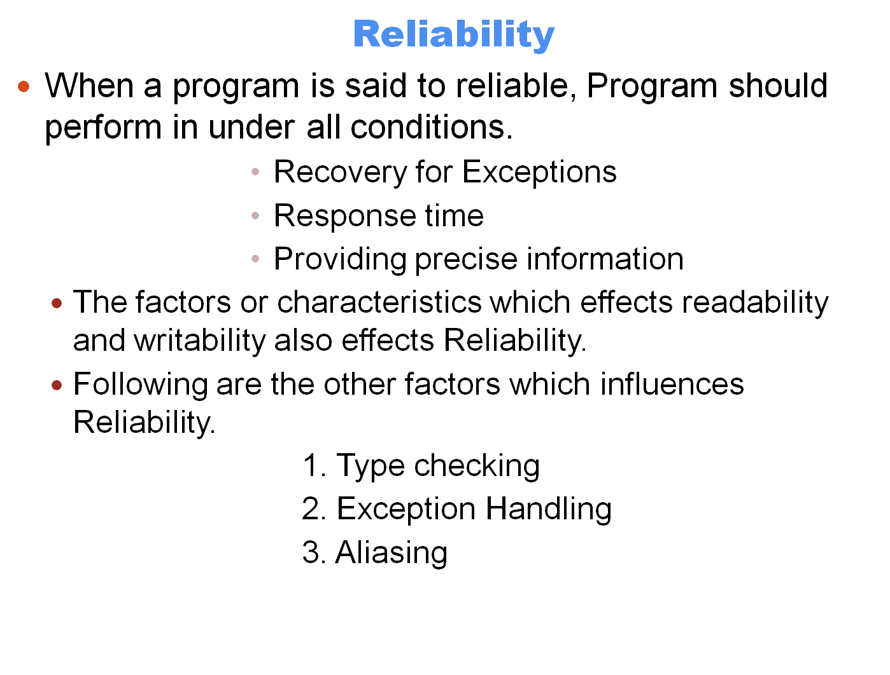

Slide 25
Type Checking
Type checking is simply testing for type errors in a given program, either by the compiler or during program execution.
The run-time type checking is expensive, compiler-time checking is more desirable.
The design of java requires checks of the types of nearly all variables and expressions at compile time.
This virtually eliminates type errors at run time in java programs.

Slide 26
One example of how failure to type check, at either compile time or run time, has led to countless program errors is the use of subprogram parameters in the original C language (Kernighan and Ritchie, 1978).
In this language, the type of an actual parameter in a function call was not checked to determine whether its type matched that of the corresponding formal parameter in the function.
Exception Handling
The ability of a program to intercept run-time errors (as well as other unusual conditions detected by the program), take corrective measures, and then continue is a great aid to reliability.
This language facility is called exception handling.
Ada, C++ and java include extensive capability for exception handling.

Slide 27
Aliasing
Loosely defined, aliasing is having two or more distinct names that can be used to access the same memory cell.
It is now widely accepted that aliasing is a dangerous feature in a programming language.
Most programming languages allow some kind of aliasing—for example, two pointers set to point to the same variable, which is possible in most languages

Slide 28
INFLUENCES ON LANGUAGE DESIGN
In addition to those factors described in previous section, several other factors influence the basic design of PL.
The most important of these are computer architecture and program design methodology.
COMPUTER ARCHITECTURE
The basic architecture of computers has had a profound effect on language design. Most of the popular languages of the past 50 years have been designed around the prevalent computer architecture, called the von Neumann architecture.
These languages are called imperative languages.
In a von Neumann computer, both data and programs are stored in the same memory.

Slide 29
The central processing unit (CPU), which executes instructions, is separate from the memory.
Therefore, instructions and data must be transmitted, or piped, from memory to the CPU.
Results of operations in the CPU must be moved back to memory.
Because of the von Neumann architecture, the central features of imperative languages are variables, which model the memory cells; assignment statements, which are based on the piping operation; and the iterative form of repetition, which is the most efficient way to implement repetition on this architecture.
Operands in expressions are piped from memory to the CPU, and the result of evaluating the expression is piped back to the memory cell represented by the left side of the assignment.

Slide 30

Von Neumann Architecture
Memory
Code/ Data
ALU
CU

Slide 31
A functional, or applicative, language is one in which the primary means of computation is applying function to given parameters.
Programming can be done in a functional language without the kind of variables that are used in imperative languages, without assignment statements and without iteration.
Programming Methodologies
The late 1960 and early 1970 brought an intense analysis, begun in large part by the structured programming movement, of both the software development process and programming language design.
The shift in the major cost of computing from hardware to software, as hardware costs decreased and programmer costs increased.odo

Slide 32
The new software development methodologies that emerged as a result of the research of the 1970s were called top-down design and stepwise refinement.
In the late 1970s, a shift from procedure-oriented to data-oriented program methodologies began.
Data-oriented methods emphasize data design, focusing on the use of abstract data types to solve problems.
The evaluation of data-oriented software development, which began in the early 1980, is object oriented design.
Object-oriented methodology begins with data abstraction, which encapsulate processing with data objects and hides access to data, and adds inheritance and dynamic method binding.

Slide 33
Object oriented programming developed along with a language that supported its concepts: samlltalk.
Although Smalltalk never became as widely used as many other languages, support for object-oriented programming is now part of most popular imperative languages, including Ada 95 (ARM, 1995), Java, C++, and C#.
Language categories
PL Are often categorized into four bins: imperative, functional, logic and object oriented.
Object oriented software development paradigm differ greatly from procedure oriented paradigm usually used with imperative languages.
For example, the expressions, assignments and control statements of C and Java are nearly identical.
On the other hand, the arrays, subprograms and semantics of java are very different from those of C.

Slide 34
Another kind of language, the visual language, is a subcategory of the imperative languages.
The most popular visual languages are the .NET languages.
These languages (or their implementations) include capabilities for drag-and-drop generation of code segments.
Such languages were once called fourth-generation languages, although that name has fallen out of use.
The visual languages provide a simple way to generate graphical user interfaces to programs.
Some authors refer to scripting languages as a separate category of programming languages.
The languages that are typically called scripting
languages, among them Perl, JavaScript, and Ruby, are imperative languages in every sense.

Slide 35
A logic programming language is an example of a rule-based language.
In an imperative language, an algorithm is specified in great detail, and the specific order of execution of the instructions or statements must be included.
In a rule-based language, however, rules are specified in no particular order, and the language implementation system must choose an order in which the rules are used to produce the desired result.
This approach to software development is radically different from those used with the other two categories of languages and clearly requires a completely different kind of language.
Prolog, the most commonly used logic programming language A logic programming language is an example of rule-based language.

Slide 36
Language Design Trade-Offs
The programming language evaluation criteria described in previous Section provide a framework for language design., But unfortunately, that framework is self-contradictory.
Two criteria that conflict are reliability and cost of execution.
For example, the Java language definition demands that all references to array elements be checked to ensure that the index or indices are in their legal ranges.
This step adds a great deal to the cost of execution of Java programs that contain large numbers of references to array elements.
C does not require index range checking, so C programs execute faster than semantically equivalent Java programs, although Java programs are more reliable.

Slide 37
The conflict between writability and reliability is a common one in language design.
The pointers of C++ can be manipulated in a variety of ways, which supports highly flexible addressing of data.
Because of the potential reliability problems with pointers, they are not included in Java.

Slide 38
Implementation Methods
Two of the primary components of a computer are its internal memory and its processor.
The internal memory is used to store programs and data.
The processor is a collection of circuits that provides a realization of a set of primitive operations , or machine

Slide 39
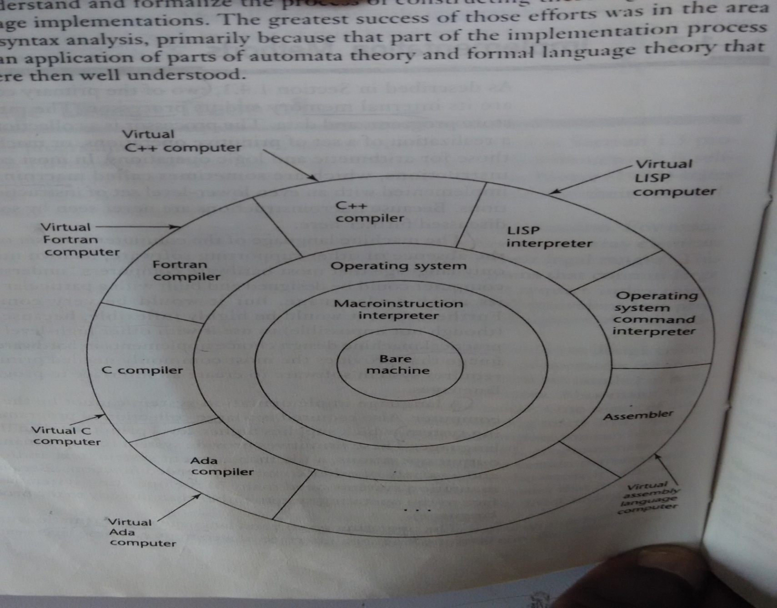

Slide 40
Compilation
Programming languages can be implemented by any of three general methods.
The programs can be translated into machine language, which can be executed directly on the computer .
This is called a compiler implementation.
This method has the advantage of very fast program execution, once the translation process is complete.
Most production implementations of languages such as C , COBOL, and Ada are by compilers

Slide 41
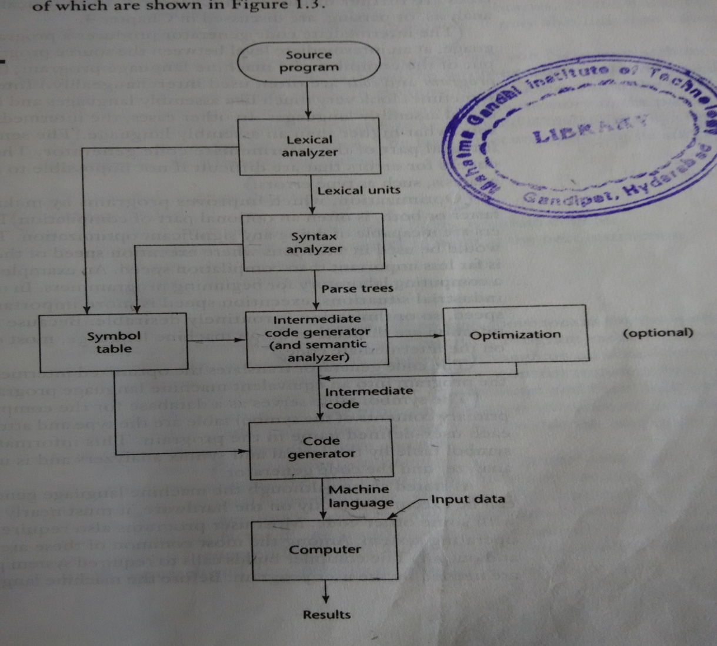

Slide 42
The lexical analyzer gathers the characters of the source program into lexical units.
The lexical units of a program are identifiers, special words, operators, and punctuation symbols.
The lexical analyzer ignores comments in the source program , because the compiler has no use for them.
The syntax analyzer takes the lexical units form the lexical analyzer and uses them to construct hierarchical structures called parse trees.
These parse trees represent the syntactic structure of the program

Slide 43
The intermediate code generator produces a program in a different language, at an intermediate level between the source program and the final output of the compiler , the machine language program.
The semantic analyzer is an integral part of the intermediate code generator.
The semantic analyzer checks for errors that are difficult if not impossible to detect during syntax analysis such as type errors.

Slide 44
Optimization, which improves programs by making them smaller or faster or both , is often an optional part of compilation.
Because many kinds of optimization are difficult to do on machine language, most optimization is done on the intermediate code.
The code generator translates the optimized intermediate code version of the program into an equivalent machine language program.

Slide 45
The symbol table serves as a database for the compilation process.
The primary contents of the symbol table are the type and attribute information of each user-defined name in the program.
This information is placed in the symbol table by the lexical and syntax analyzers and is used by the semantic analyzer and the code generator.

Slide 46
Pure Interpretation
Pure interpretation lies at the opposite end (from compilation) of implementation methods.
With this approach, programs are interpreted by another program called an interpreter, with no translation whatever.
The interpreter program acts as a software simulation of a machine whose fetch-execute cycle deals with high-level language program statements rather than machine instructions.

Slide 47
Pure interpretation has the advantage of allowing easy implementation of many source-level debugging operations, because all run-time error messages can refer to source-level units.
For example, if an array index is found to be out of range, the error message can easily indicate the source line and the name of the array.
On the other hand, this method has the serious disadvantage that execution is 10 to 100 times slower than in compiled systems.
The primary source of this slowness is the decoding of the high-level language statements, which are far more complex than machine language instructions (although there may be fewer statements than instructions in equivalent machine code).
Furthermore, regardless of how many times a statement is executed, it must be decoded every time.

Slide 48
Another disadvantage of pure interpretation is that it often requires more space.
In addition to the source program, the symbol table must be present during interpretation.
Although some simple early languages of the 1960s (APL, SNOBOL, and LISP) were purely interpreted, by the 1980s, the approach was rarely used on high-level languages.
However, in recent years, pure interpretation has made a significant comeback with some Web scripting languages, such as JavaScript and PHP, which are now widely used.

Slide 49
Hybrid implementation systems
Some language implementation systems are compromise between compilers and interpreters; they translate high level language programmes to a intermediate language designed to allow easy interpretation.
This method is faster than pure interpretation because the source language statements are decoded only once.
Such a implementations are called Hybrid implementation systems.
Instead of translating intermediate language to machine code, it simply interprets intermediate code.

Slide 50
Perl is implemented with a hybrid system.
Initial implementations of Java were all hybrid.
Its intermediate form ,byte code, provides portability to any machine that as the byte code interpreter and associated run time system.
Together these are called the Java Virtual Machine.

Slide 51
PROGRAMMING ENVIRONMENTS
A Programming environment is a collection of tools used in the development of software.
This collection may consists of only a file system, a text editor, a linker and a compiler.
Unix is an older programming environment, first distributed in the middle 1970s, built around a portable multiprogramming operating system.
In the past, the most important feature absent from UNIX was a uniform interface among its tools.
This made it more difficult to learn and to use. However
UNIX is now often used through a graphical user interface (GUI) that runs on top of UNIX.
Examples of UNIX GUIs are the Solaris Common Desktop Environment (CDE), GNOME, and KDE.
These GUIs make the interface to UNIX appear similar to that of Windows and Macintosh systems.

Slide 52
Borland J Builder is a programming environment that provides an integrated compiler, editor, debugger and file system for java development.
The latest step in the evaluation of software development environments is represented by Microsoft Visual Studio .Net
This is a large elaborate collection of software tools, all used through a windowed interface.
This system can be used to develop software in any one of the five C#, Visual BASIC .NET, JScript (Microsoft’s version of JavaScript), F# (a functional language), and C++/CLI.
NetBeans is a development environment that is primarily used for Java application development but also supports JavaScript, Ruby, and PHP.

Slide 53
Evolution of Major Programming Languages
Zuse’s Plankalkül
Between 1936 and 1945, German scientist Konrad Zuse (pronounced “Tsoozuh”) built a series of complex and sophisticated computers Z4 (latest model).
Working alone, Zuse embarked on an effort to develop a language for expressing computations for the Z4, He named this language Plankalkül, which means program calculus.
The simplest data type in Plankalkül was the single bit. Integer and floating-point numeric types were built from the bit type.
In addition to the usual scalar types, Plankalkül included arrays and records (called structs in the C-based languages).
Each statement consisted of either two or three lines of code.
The first line was most like the statements of current languages.
The second line, which was optional, contained the subscripts of the array references in the first line.

Slide 54
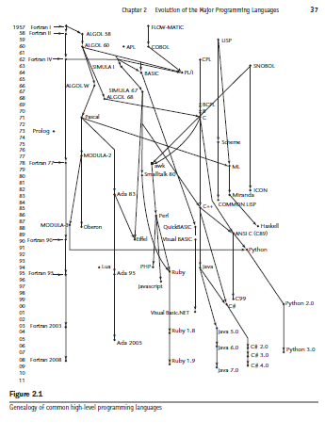

Slide 55
The last line of each Plankalkül statement contained the type names for the variables mentioned in the first line.
The following example assignment statement, which assigns the value of
the expression A[4] +1 to A[5], illustrates this notation.
The row labeled V is for subscripts, and the row labeled S is for the data types.
In this example, 1.n means an integer of n bits:
| A + 1 => A
V | 4 5
S | 1.n 1.n
Pseudocodes
First, note that the word pseudocode is used here in a different sense than its
contemporary meaning.
The computers that became available in the late 1940s and early 1950s were far less usable than those of today.
There were no high-level programming languages or even assembly languages,
so programming was done in machine code.
For example, an ADD instruction might be specified by the code 14 rather than a connotative textual name, even if only a single letter.
This makes programs very difficult to read.
Short Code:The first of these new languages, named Short Code, was developed by John Mauchly in 1949 for the BINAC computer, later transferred to a UNIVAC I computer.
Speed coding:In other places, interpretive systems were being developed that extended machine languages to include floating-point operations.
The Speedcoding system developed by John Backus for the IBM 701 is an example of such a system (Backus, 1954).

Slide 56
Syntax and Semantics
The study of programming languages, like the study of natural languages, can be divided into examinations of syntax and semantics.
The syntax of a programming language is the form of its expressions, statements, and program units.
Its semantics is the meaning of those expressions, statements, and program units.
For example, the syntax of a Java while statement is
while (boolean_expr) statement
The semantics of this statement form is that when the current value of the Boolean expression is true, the embedded statement is executed.
Otherwise, control continues after the while construct.

Slide 57
The General Problem of Describing Syntax
A language, whether natural (such as English) or artificial (such as Java), is a set of strings of characters from some alphabet.
The strings of a language are called sentences or statements.
The syntax rules of a language specify which strings of characters from language’s alphabet are in the language.
The low-level syntactic units (small units) are called lexemes.
The lexemes of a programming language include its identifiers, literals, operators and special words.
The token of a language is a category of its lexemes.

Slide 58
Consider the following java statement
Index = 2 * count + 17;
The lexemes and tokens of this statement are
Lexemes | Tokens
Index | identifier
= | equal_sign
2 | int_literal
* | mult_op
Count | identifier
+ | plus_op
17 | int_literal
; | semicolon

Slide 59
Language Recognizers
In general, languages can be formally defined in two distinct ways: by recognition and by generation.
Suppose we have a language L that uses an alphabet of characters.
To define L formally using the recognition method, we would need to construct a mechanism R, called a recognition device, capable of reading strings of characters from the alphabet .
R would indicate whether a given input string was or was not in L.
Such devices are like filters, separating legal sentences from those that are incorrectly formed.
In effect, R would either accept or reject the given string.
If R, when fed any string of characters over , accepts it only if it is in L, then R is a description of L.
Because most useful languages are, for all practical purposes, infinite, this might seem like a lengthy and ineffective process.

Slide 60
The syntax analysis part of a compiler is a recognizer for the language the compiler translates.
In this role, the recognizer need not test all possible strings of characters from some set to determine whether each is in the language.
Rather, it need only determine whether given programs are in the language.
In effect then, the syntax analyzer determines whether the given programs are syntactically correct.
The structure of syntax analyzers, also known as parsers.

Slide 61
Language Generators
A language generator is a device that can be used to generate the sentences of a language.
We can think of the generator as having a button that produces a sentence of the language every time it is pushed.
Because the particular sentence that is produced by a generator when its button is pushed is unpredictable, a generator seems to be a device of limited usefulness as a language descriptor.
However, people prefer certain forms of generators over recognizers because they can more easily read and understand them.

Slide 62
1.Language Recognizers accept a Language.
Recognizers are Machines. The Machines take a string as input. The Machines will accept the input if when run, the Machine stops at an accept state. Otherwise the input is rejected. If a Machine M recognizes all strings in Language L, and accepts input provided by a given string S, M is said to accept S. Otherwise M is said to reject S. S is in L if and only if M accepts S.
Language Generators create the strings of a Language.
Generators are string constructors. A generator provides a construction description. If a generator is able to construct all stings in a Language L, and every string S that can be constructed by that generator is in L, we can say that the generator is a generator for the language L. If there is no way to construct a string S from the generator, S is not in L.
Context Free Grammars (CFGs) are a well known type of language generators.
Push Down Automatas (PDAs) are a well known form of language recognizers.
CFGs generate the same class of languages that are recognized by PDAs.
2.here are two formal approaches to describing syntax:Recognizers
  Given a string, a recognizer for a language L tells whether or not the string is in L (ex: Compiler)
Generators
  A generator for L will produce an arbitrary string in L on demand. (ex: Grammar, BNF)
Recognition and generation are useful for different things, but are closely related

Slide 63
Backus-Naur Form and Context-Free Grammars
In 1950, two men, Noam Chomsky and John Backus, developed the syntax description formalism, which subsequently became the most widely used method for programming language syntax.
Context-free Grammars
Chomsky described four classes of generative devices or grammars that define four classes of languages.
Two of these grammars classes, named context-free and regular, turned out to be useful for describing the syntax of programming languages.
The tokens of programming languages can be described by regular grammars.
Whole programming languages, with minor exceptions, can be described by context-free grammars.

Slide 64
Fundamentals
A meta-language is language that is used to describe another language.
BNF is a meta-language for programming languages.
BNF uses abstractions for syntactic structures.
A simple java assignment statement
<assign> → <var> = <expression>
1.The symbol on the left side of the arrow, called the left-hand side(LHS), is the abstraction being defined.
2. The text to the right of the arrow is the definition of the LHS.
3. It is called the right-hand-side (RHS) and consist of some mixture of tokens, lexemes an reference to other abstraction.
4. A definition is called a rule or production.

Slide 65
The abstraction in a BNF description or grammar are called non-terminal symbols or simply non-terminals.
The lexemes and tokens of the rules are called terminal symbols or terminals.
Multiple definitions can be written as a single rule, with the different definitions separated by the symbol ‘|’.
For example, an Ada if statement can be described with the rules
<if_stmt> -> if <logic_expr) then <stmt>
<if_stmt> -> if <logic_expr) then <stmt> else <stmt>
Or with the rule
<if_stmt> -> if <logic_expr) then <stmt>
| if <logic_expr) then <stmt> else <stmt>

Slide 66
Describing Lists
Variable-length lists in mathematics are often written using an ellipse (…).
BNF does not include the ellipsis.
The most alternative is recursion.
A rule recursive if its LHS appears in its RHS.
The following rues illustrate how recursion is used to describe lists:
<iden_list> -> Identifier
| identifier, <ident_list>
This defines <ident_list> as either a single token (identifier) or an identifier followed by a comma followed by another instance of <ident_list>

Slide 67
Grammars and Derivations
A grammar is a generative device for defining languages.
The sentences of the language are generated through a sequence of applications of the rules, beginning with a special non-terminal of the grammar called the start symbol.
A sentence generation is called a derivation.
A Grammar for Small Language
<program> → begin <stmt_list> end
<stmt_list> → <stmt>
| <stmt> ; <stmt_list>
<stmt> → <var> = <expression>
<var> → A | B | C
<expression> → <var> + <var>
| <var> – <var>
| <var>

Slide 68
The language in example has only one statement.
A program consists of a special word begin, followed by a list of statements separated by semicolons, followed by the special word end.
A derivation of a program in this language follows:
<program> => begin <stmt_list> end
=> begin <stmt>; <stmt_list> end
=> begin <var>= <expression>;<stmt_list> end
=> begin A= <expression>;<stmt_list> end
=> begin A= <var>+<var>;<stmt_list> end
=> begin A= B+<var>;<stmt_list> end
=> begin A= B+C;<stmt_list> end
=> begin A= B+C;<stmt> end
=> begin A= B+C;<var> = <expression> end
=> begin A= B+C;<var> = <expression> end
=> begin A= B+C; B = <expression> end
=> begin A= B+C; B = <var> end
=> begin A= B+C; B = C end

Slide 69
This derivations, begins with the start symbol, in this case <program>.
The symbol => is read “derives”.
Each successive string in the sequence is derived from the previous string by replacing one of the non-terminals with one of that non-terminal’s definitions.
Each derivation, include <program>, is called a sentential form.
In this derivation, the replaced non-terminal is always the leftmost non-terminal in the previous sentential form.
Derivations that use this order of replacement are called leftmost derivations.
The derivation continues until the sentential from contains no non-terminals.
That sentential form, consisting of only terminals, or lexemes, is the generated sentence.
A derivation may be rightmost or in an order that is neither leftmost nor rightmost.
i

Slide 70
Derivation order has no effect on the language generated by a grammar.
By choosing alternative RHS of rules with which to replace non-terminals in the derivation, different sentences in the language can be generated.
By exhaustively choosing all combinations of choices, we can generate the entire language.
A Grammar for Simple Assignment Statements
<assign> → <id> = <expr>
<id> → A | B | C
<expr> → <id> + <expr>
| <id> * <expr>
| ( <expr> )
| <id>
The grammar of Example describes assignment statements whose right sides are arithmetic expressions with multiplication and addition operators and parentheses.
For example, the statement :A = B * ( A + C ) is generated by the leftmost derivation.

Slide 71
<assign> => <id> = <expr>
=> A = <expr>
=> A = <id> * <expr>
=> A = B * <expr>
=> A = B * ( <expr> )
=> A = B * ( <id> + <expr> )
=> A = B * ( A + <expr> )
=> A = B * ( A + <id> )
A = B * ( A + C )
Parse Trees
One of the most attractive features of grammars is that they naturally describe the hierarchical syntactic structure of the sentences of the languages they define.
These hierarchical structures are called parse tress.
For example, the parse tree in Figure shows the structure of the assignment statement derived previously
Every internal node of a parse tree is labeled with a non-terminal symbol: every leaf is labeled with a terminal symbol.
Every sub-tree of a parse tree describes one instance of an abstraction in the sentence.

Slide 72
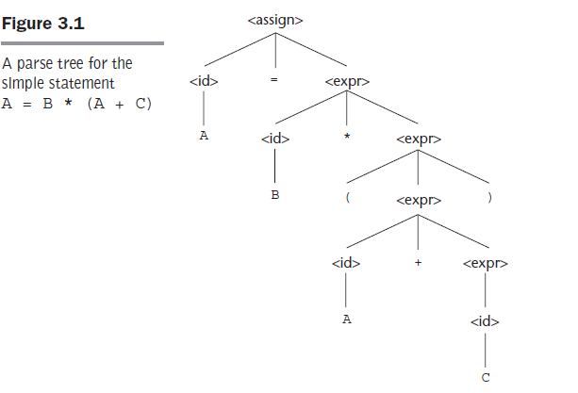
Every sub-tree of a parse tree describes one instance of an abstraction in the sentence.

Slide 73
Ambiguity
A grammar that generates a sentential form for which there are two or
more distinct parse trees is said to be ambiguous.
Example
An ambiguous Grammar for simple Assignment Statements
<assign> -> <id> = <expr>
<id> -> A | B | C
<expr> -> <expr> + <expr>
| <expr> * <expr>
| (<expr>)
| <id>
The grammar of above example is ambiguous because the sentence
A = B + C * A
Has two distinct parse trees as shown in Fig.

Slide 74
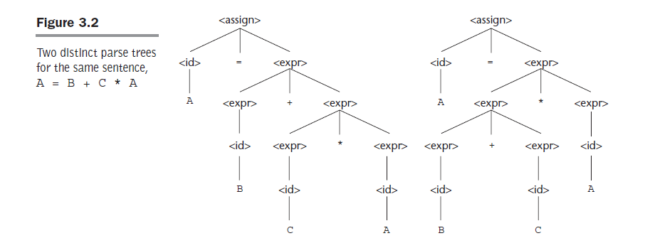

Slide 75
The ambiguity occurs because the grammar specifies slightly less syntactic structure than does the grammar of previous example.
Rather than allowing the parse tree of an expression to grow only on the right, this grammar allows growth on both the left and the right.
Syntactic ambiguity of language structures is a problem because compilers often base the semantics of those structures on their syntactic form.
Specifically, the compiler decides what code to generate for a statement examining its parse tree.
If a language structure has more than one parse tree then the meaning of the structure can’t be determine uniquely.
Some parsing algorithms can be based on ambiguous grammars.
When such parser encounters an ambiguous construct, it uses non-grammatical information provided by the designer to construct the correct parse tree.

Slide 76
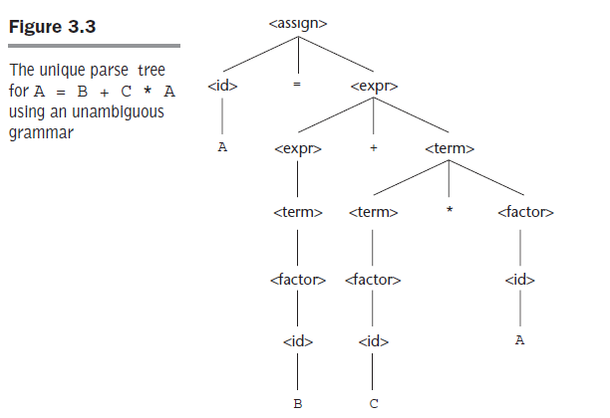
Operator Precedence
As stated earlier, a grammar can describe a certain syntactic structure
so that part of the meaning of the structure can be determined from its
parse tree.
In particular, the fact that an operator in an arithmetic expression is
generated lower in the parse tree (and therefore must be evaluated first) can be used to indicate that it has over an operator produced higher up in the tree.
A grammar can be written to separate the addition and multiplication
operators so they are consistently in a higher to lower ordering,
respectively, in the parse tree.

Slide 77
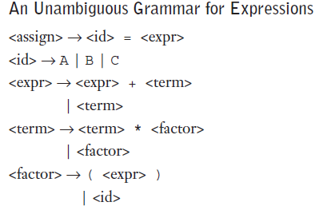
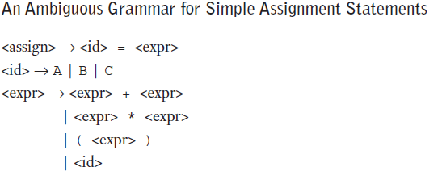
This ordering can be maintained regardless of the order in which
operators appear in an expression.
The correct ordering is specified by using separate abstractions for the operands of the operators that have different precedence.
This requires additional non terminals and some new rules.
Example An unambiguous Grammar for expressions.
<assign> -> <id> = <expr>
<id> -> A| B | C
<expr> -> <expr> + <term>
| <term>
<term> -> <term> + <factor>
| <factor>
<factor> -> (<assign>)
| <rid>
The grammar in example generates the same language as the grammar of examples 3.2 and 3.3,but it indicates the usual precedence order of

Slide 78
multiplication and addition operators.
<assign> => <id> = <expr>
=> A = <expr>
=> A = <expr> + <term>
=> A = <term> + <term>
=> A = <factor>+ <term>
=> A = <id>+ <term>
=> A = B + <term>
=> A = B + <term> * <factor>
=> A = B + <factor> * <factor>
=> A = B + <id> * <factor>
=> A = B + C * <factor>
=> A = B + C * <id>
=> A = B + C * A

Slide 79
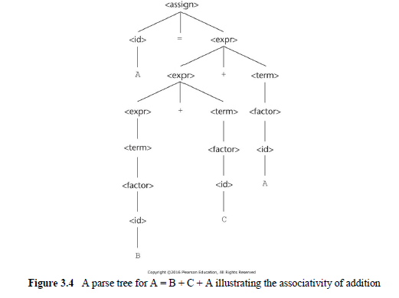
Associativity of Operators
Do parse trees for expressions with two or more adjacent occurrences of operators with equal precedence have those occurrences in proper hierarchical order?
An example of an assignment using the previous grammar is: A = B + C + A .
Figure above shows the left + operator lower than the right + operator. This is the correct order if + operator meant to be left associative, which is typical.
When a grammar rule has LHS also appearing at beginning of its RHS, the rule is said to be left recursive. The left recursion specifies left associativity.
In most languages that provide it, the exponentiation operator is right associative. To indicate right associativity, right recursion can be used.
A grammar rule is right recursive if the LHS appears at the right end of the RHS. Rules such as

Slide 80
Extended BNF
Because of a few minor inconvenience in BNF, it has been extended in several ways.
The most extended versions are called Extended BNF, simply EBNF.
Three extensions are commonly included in the various versions of EBNF.
The first of these denotes an optional part of RHS, which is delimited by brackets.
For example, a C selection statement can be described as
<selection> -> if ( <expression> ) <statement> [ else <statement>]
Without the use of the brackets, the syntactic description of this statement would require two rules.
The second extension is the use of braces in an RHS to include that the enclosed part can be repeated indefinitely or left out altogether.

Slide 81
For example, lists of identifiers separated by commas can be described by the following rule:
<iden_list> -> <identifier> {, <identifier>}
This is a replacement of the recursion by a from of implied iteration: the part enclosed within braces can be iterated any number of times.
The third common extension deals with multiple-choice option.
When a single element must be choice from a group, the options are placed in parentheses and separated by the OR operator, |.
For example,
<term> -> <term> (* | / |%) <factor>
It requires three BNF rules to describe this structure.

Slide 82
BNF and EBNF Versions of an Expression Grammar
BNF: <expr> -> <expr> + <term>
| <expr> - <term>
| <term>
<term> -> <term> * <factor>
| <term> / <factor>
| <factor>
<factor> -> <exp> ** <factor>
| <exp>
| <factor>
<exp> -> <( <expr> )
EBNF: <expr> -> <term> { (+ | -) <term>}
<term> -> <factor> { (* | /) <factor>}
<factor> -> <exp> { ** <exp>}
<exp> -> (<expr>)
| id

Slide 83
ATTRIBUTE GRAMMAR
Attribute grammar is an extension of a context free grammar that is used to describe features of a PL that cannot be described in BNF.
The extension allows to describe certain rules more conveniently such as type compatibility rules.
One of major disadvantage of BNF is it cannot describe the static semantics.
Static semantics are related to type constraints and they indirectly effect the program during execution.
Java is the language which checks static semantics at compile time.
Attribute grammar was developed by Knuth in 1968 to address the problem of static semantics.
They give a formal way to pass semantic information (types, values, etc.) around a parse tree.
We now allow any grammar symbol X to have attributes. The attribute a of symbol X is denoted X.a

Slide 84
In Java, for example, a floating-point value cannot be assigned to an integer type variable, although the opposite is legal.
To describing the rule that float variables can be assigned integer values but the reverse is not true is difficult to describe complete in BNF.
The rule requiring that all variables must declared before being used is impossible to describe in BNF.
They give a formal way to pass semantic information (types, values, etc.) around a parse tree.
We now allow any grammar symbol X to have attributes. The attribute a of symbol X is denoted X.a

Slide 85
Static Semantics
As an example of a syntax rule that cannot be specified in BNF, consider the common rule that all variables must be
declared before they are referenced.
It has been proven that this rule cannot be specified in BNF.
These problems exemplify the categories of language rules
called static semantics rules.
The static semantics of a language is only indirectly related to the meaning of programs during execution; rather, it has to do with the legal forms of programs (syntax rather than semantics).
Static semantics is so named because the analysis required to check these specifications can be done at compile time.
The following tasks should be performed in semantic analysis:
1.Scope resolution 2.Type checking 3.Array-bound checking.

Slide 86
Attribute Grammar
Attribute grammar is a special form of context-free grammar where some additional information (attributes) are appended to one or more of its non-terminals in order to provide context-sensitive information.
Each attribute has well-defined domain of values, such as integer, float, character, string, and expressions.
Attribute grammar is a medium to provide semantics to the context-free grammar and it can help specify the syntax and semantics of a programming language.
Attribute grammar (when viewed as a parse-tree) can pass values or information among the nodes of a tree.
Example:
E → E + T { E.value = E.value + T.value }
The right part of the CFG contains the semantic rules that specify how the grammar should be interpreted.
Here, the values of non-terminals E and T are added together and the result is copied to the non-terminal E.

Slide 87
Defining attribute grammar
A(X) is a set of attributes associated for each grammar symbol X.
A(X) is said to be attribute grammar it should contain 2 disjoint sets S(X) & I(X). Where S(X) contains synthesized attribute & I(X) contain Inherited attributes.
Synthesized attributes represents actual type. Whereas Inherited attribute represents Expected type.
In Attribute grammar, Every rule is associated with a set of semantic functions & predicate functions.
Lets us consider a generalized rule X₀ → X₁, X₂,….. X_{N.}
Synthesized attribute X₀ is compute with semantic function
S(X₀) = F( A(X₁),A(X₂),……A(X_{N}))
Synthesized attribute values depends on the values of its children nodes

Slide 88
Inherited attribute of X_{j} (1≤ j≥ n) is computed with semantic function
I(X_{j}) = F( A(X₀),A(X₁),……A(X_{N}))
Inherited attribute values depends on the parent or its sibling values.
Predicate function :- It is used to validate the grammar rule, it returns true when attribute grammar rule is valid otherwise it will return false.
If all the attribute values are computed in a parse tree, then tree is said to be fully attributed tree.
Intrinsic attributes :- these are synthesized attributes of leaf nodes whose values are computed outside the parse tree.
For Example :-
The type of variable comes from symbol table.

Slide 89
Example of attribute grammar
Lets take syntax portion of simple assignment statement.
<assign> → <var> = <expr>
<expr> → <var> + <var>
|<var>
<var> → A|B|C
Static semantics
variable can be any one of 2 types : int or real
If RHS consists 2 variables which are mixed type then real type is the expression type.
RHS type should be same as LHS TYPE

Slide 90
Attributes in the grammar given as
Actual type : A synthesized attribute associated with <var> or <expr>. Here <var> is a Intrinsic type and its value is obtained from symbol table. <expr> actual type can be computed from its child node or children nodes.
Expected type :- A Inherited type only associated with a non-terminal <expr>
<expr> expected type can be computed by the type of the variable on the left side of assignment operator.

Slide 91
Complete attribute grammar
1. syntax : <assign> → <var> = <expr>
semantic : <expr>.expected type ← <var>.actual type
2. syntax : <expr> → <var>[1] + <var>[2]
semantic : <expr>.actualtype ←
if( <var>[1].actualtype == int && <var>.[2]actual type == int)
then
return int
else
return real
end if
predicate : <expr>.expected type == <expr>.actual type
3. syntax : <expr> = <var>
semantic : <expr>.actualtype ← <var>.actual type
predicate : <expr>.expected type == <expr>.actual type
4. syntax : <var> = A | B | C
semantic : <var>.actual type ← lookup(<var>.string>)
Here lookup () function is used get the type based on the variable name.

Slide 92
Parse tree for simple assignment statement using attribute grammar
A = A +B
<assign>
Expected type
<expr>
Actual type
<var>
<var>[1]
<var> [2]
Actual type
Actual type
Actual type
A
=
A
+
B

Slide 93
Computing attribute values
1. <var>.actual type ← lookup(A) ---RULE 4
2. <expr>. Expected type ← <var>.actualtype –RULE 1
3. <var>[1] .actual type ← lookup(A) ---RULE 4
<var>[2] .actual type ← lookup(A) ---RULE 4
4. <expr>.actual type ← either int or real –RULE 2
5. <expr>.expected type == <expr>.actual type (true or false) – RULE 2 OR RULE 3

Slide 94
Lets assign type to A = A +B
  A is real type
  B is int type
  Apply the rules
Predicate : <expr>.expected type == <expr>.actual type is true
<assign>
exptd type = real
Exptd type= Real
<expr>
Actual type = real
<var>
<var>[1]
<var> [2]
Act type = Real
Act type = int
Act type = Real
A
=
A
+
B
Real
Real
int

Slide 95
Describing the Meanings of Programs: Dynamic Semantics
We now turn to the difficult task of describing the dynamic semantics, or meaning, of the expressions, statements, and program units of a programming language.
Because of the available notation, describing syntax is a relatively simple matter. On the other hand, no universally accepted notation or approach has been devised for dynamic semantics.
Programmers obviously need to know precisely what the statements of a language do before they can use them effectively in their programs.
Three methods of semantic description: –
1.Operational semantics: It is a method of describing the meaning of language constructs in terms of their effects on an ideal machine.
2.Denotation semantics: Mathematical objects are used to represents the meanings of languages constructs. Language entities are converted to these mathematical objects with recursive functions.
3.Axiomatic semantics: It is based on formal logic and devised as a tool for proving the correctness of programs.

Slide 96
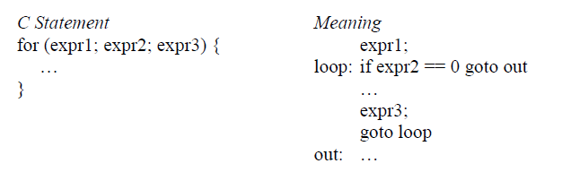
Operational Semantics
The idea behind operational semantics is to describe the meaning of a statement or program, by specifying the effects of running it on a machine.
The effects on the machine are viewed as the sequence of changes in its states, where the machine’s state is the collection of the collection of the values in its storage.
Most programmers have written a small test program to determine the meaning of some programming language construct.
The basic process of operational semantics is not unusual.
In fact, the concept is frequently used in programming textbooks and programming in reference manuals.
For example, the semantics of the C for construct can described in terms of simpler statements, as in

Slide 97
Denotational Semantics
Introduction
Denotational semantics, we provide meaning in terms of mathematical objects, such as integers, truth values, tuples of values, and functions.
Christopher Strachey and his Programming Research Group at Oxford developed Denotational semantics in the mid 1960s.
It is mainly based on recursive function theory.
The name Denotation is because the mathematical objects are used to denote the meaning of the program.

Slide 98
Examples
Syntax of the Binary numbers is
<bin_num> → ‘0’
| ‘1’
| <bin_num> ‘0’
| <bin_num> ‘1’
Let the domain of semantic values of the objects be N, the set of non negative decimal integers.
Now, we have to associate with binary numbers
The semantic function, named M_{bin} Maps with the above grammar rules to objects in N.
M_{bin} (‘0’) = 0
M_{bin} (‘1’) = 1
M_{bin} (<bin_num> ‘0’) = 2 * M_{bin} (<bin_num>)
M_{bin} (<bin_num> ‘0’) = 2 * M_{bin} (<bin_num>) + 1
Number with apostrophes are syntatic digits & other numbers are mathematical digits.

Slide 99
When a program reads a number as a string it must be converted to a mathematical number before it can be used in the program.
The meanings, or denoted objects ( decimal numbers) can be attached to the nodes of the parse tree which is known as syntax – directed semantics.
<bin_num>
<bin_num> ‘0’
<bin_num> ‘1’
‘1’

Slide 100
Old Question
1.Why are strongly typed languages compiled while weakly typed languages interpreted. What is
hybrid implementation of languages? Explain.
2. Discuss about various programming domains and their associated languages.
3.Explain in detail about various language evaluation criteria and the characteristics that affect them.
4.Explain the process of compilation.
5.Distinguish between language generators and language recognizers.
6.Give grammar for simple assignment statements
7.Give an unambiguous grammar for if-then-else.
8.Explain about various programming domains
Give BNF and EBNF versions of an expression grammar

Slide 101
Explain about the Virtual Machine. (2019)[2]
What are the uses of attribute grammar? (2019)[3]
Define axiomatic semantics. (2018)[2]
Give an attribute grammar for simple assignment statements. (2018)[3]
Define and differentiate between Syntax and Semantics. (2018)[2]
What are the three fundamental features of an object-oriented programming language? (2018) [3]
List the principal phases of compilation.(2017) [2]
b) Explain the features of denotational semantics.(2017) [3]
Define syntax and semantics.(2016) [2]
b) List out language categories. (2016)[3]
Differentiate between static and dynamic semantic.(2015) [2]
b) Write EBNF description for the C union. (2015)[3]

Slide 102
2 a)Explain about the preconditions and postconditions of a given statement mean in
axiomatic semantics.(2019)
b) Describe the steps involved in the language evaluation criteria. [5+5]
3.a) Explain the different categories of languages.
b) Draw and explain the flow chart for compilation process. (2019) [5+5]
2 a)Discuss various programming domains and their associated languages.
b) Describe the basic concept of denotational semantics. (2018)[6+4]
3.a) What are the potential benefits of studying programming language concepts?
b) Explain with examples how syntactic design choices affect readability. (2018) [5+5]
2 a)What are the rules of EBNF? Explain in detail. (2018)
b) Compare the BNF with EBNF and discuss their advantages and disadvantages. [5+5]
3.a) How can knowledge of programming language characteristics benefit the whole
computing community? Explain.
b) What the primary use of attribute grammars? Discuss. [5+5]
2 a)Distinguish between ambiguous grammer and attribute grammar with an example.(2017).
b) Construct the parse tree for the simple statement. [5+5] A := B * (A + C)
3.a) Explain about the preconditions and postconditions of a given statement mean in
axiomatic semantics.
b) Describe the important factors influencing the writability of a language.

Slide 103
2 a)How can user-defined operator overloading harm the readability of a program? Explain. (2016)
b) Define grammars, derivation and a parse tree. [7+3]
3.a) Discuss about language recognizers and language generators.
b) Describe the basic concept of axiomatic semantics.
2 a)Explain the attribute grammar and also write the attribute grammar for simple
assignment statements.(2016)
b) Explain about denotational semantics and axiomatic semantics for common
programming language features. [5+5]
3.a) Explain the parse tree for the sum and average program by using the grammar.
b) Differentiate between syntax and semantics.

